Slide 1


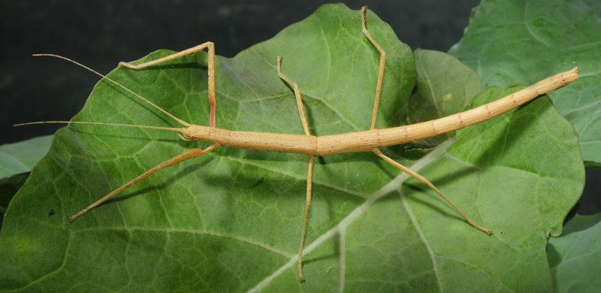
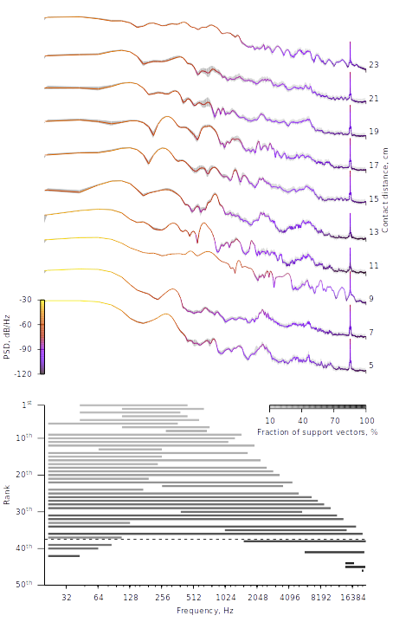
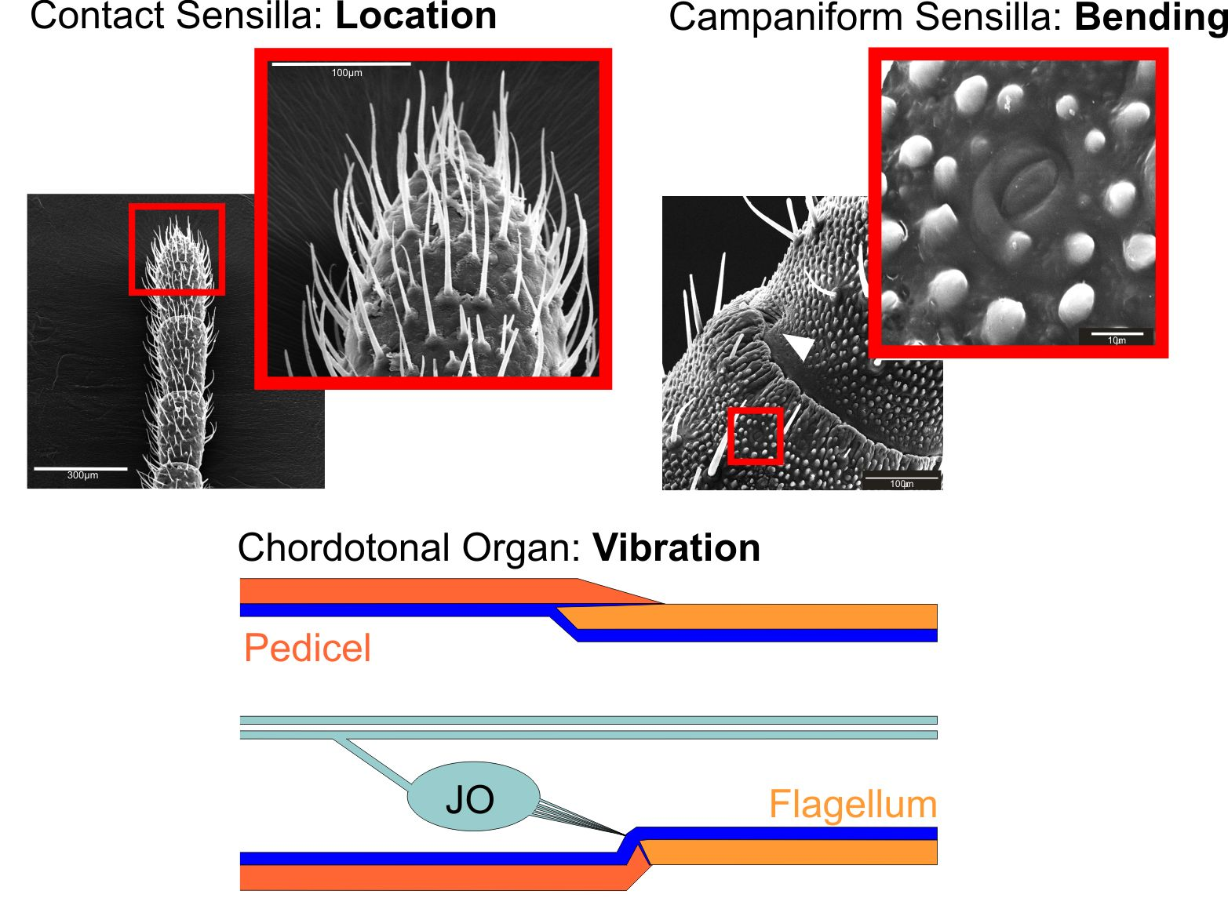
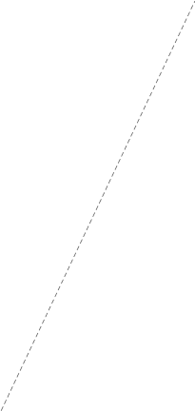
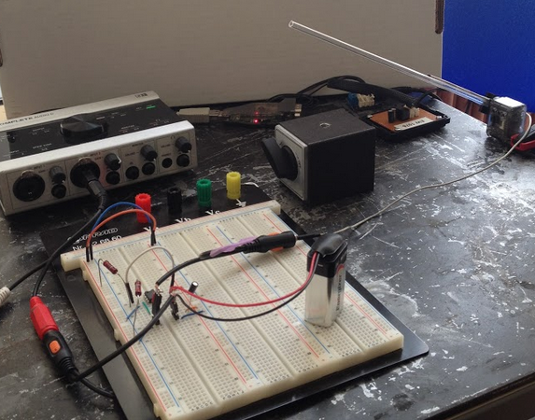
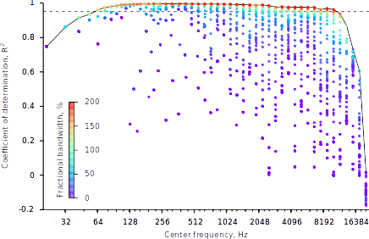
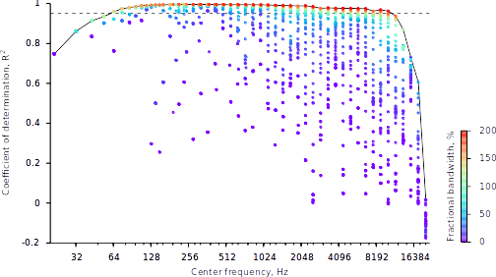


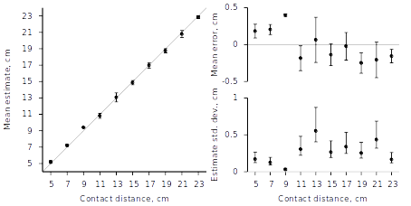
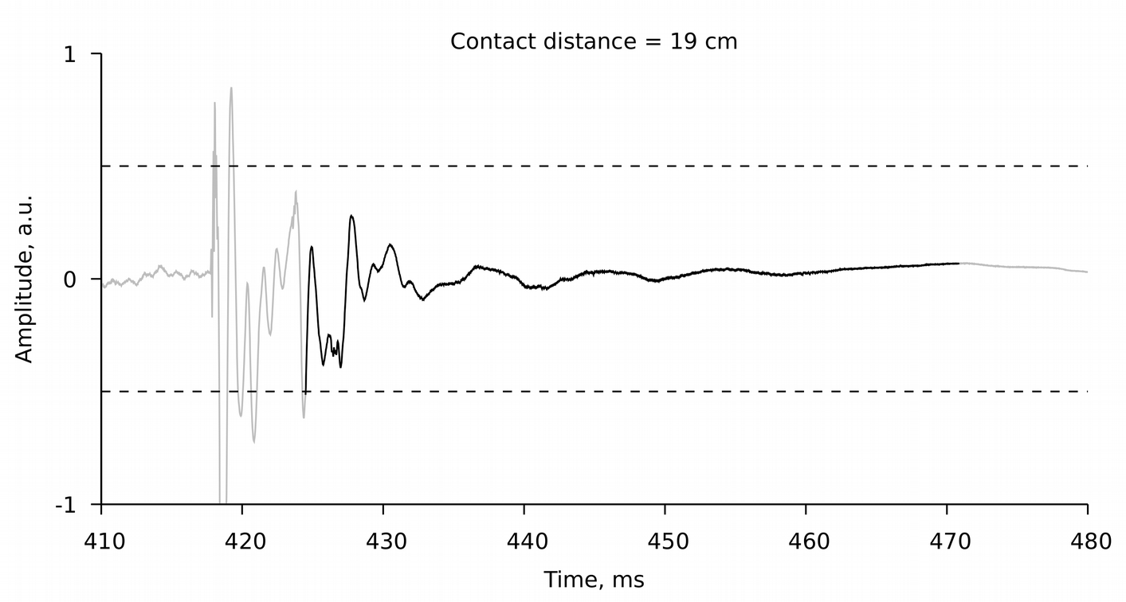
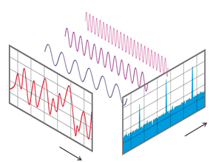
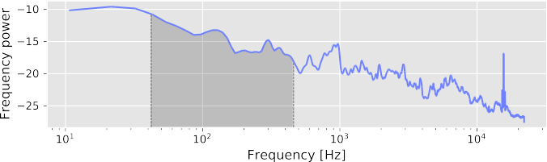
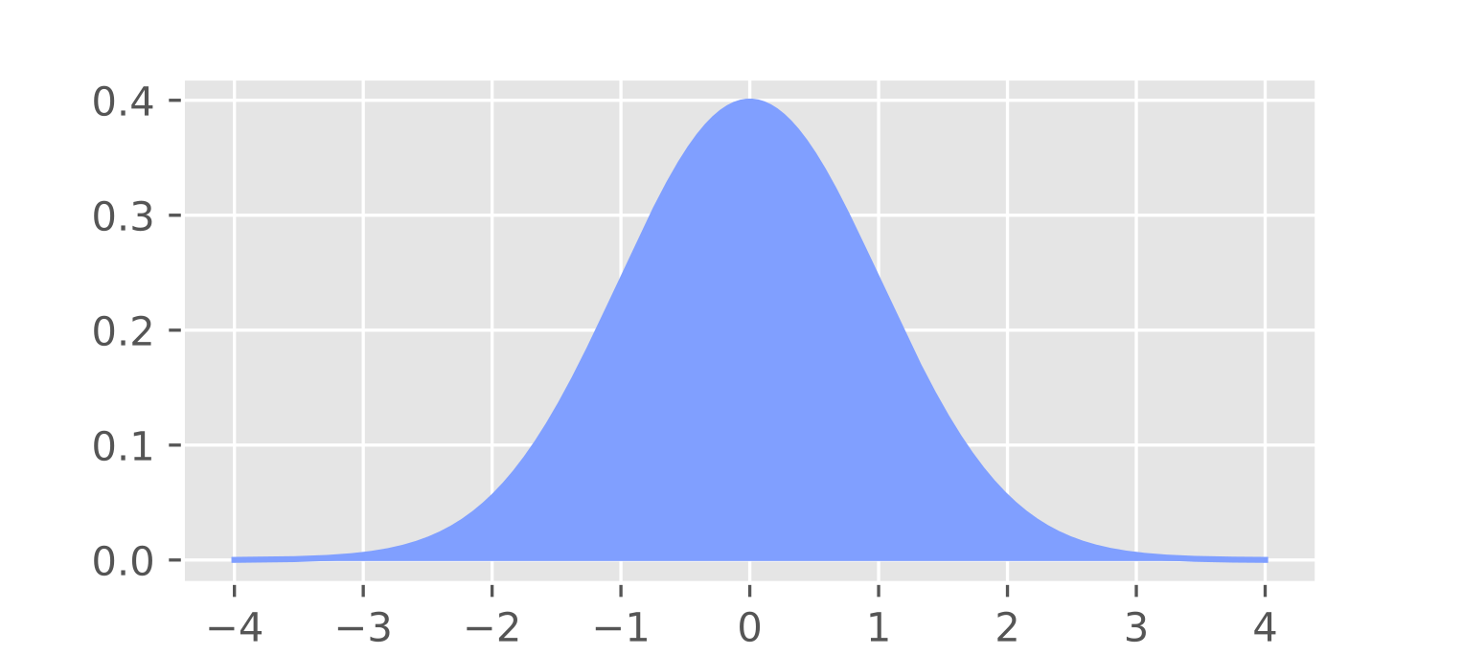
Graduate School Research Retreat
29th of November – 30th of November 2010
Graduate School Research Retreat
29th of November – 30th of November 2010
Department of
Biological Cybernetics
Toward a biomimetic Johnston’s organ for touch localization
Luca Hermes, Volker Dürr and Thierry Hoinville
thierry.hoinville@uni-bielefeld.de
Introduction
Results
Most insects use a pair of antennae to sense their near-range environment. For example, blind-folded stick insects climb obstacles by finding footholds for their front legs using their antennae [1]. Different types of mechano-receptors present on each antenna may contribute to contact localization. One of these receptors – Johnston’s organ – might respond to contact-induced vibrations [2]. Prior approaches to construct biomimetic antennae have shown that vibration characteristics can be exploited to estimate the position of a contact along the antenna, the material and texture properties of the obstacle [3,4,5]. For distance estimation, only low-frequency high-amplitude components have been exploited. Besides increasing latency due to long sampling periods required [4], maintaining extended contact phases in a realistic robot scenario appears not practical [5]. Here, we systematically evaluate which frequency bands result in best distance estimation.
Carausius morosus
Power spectra
Consistent profile per distance
Distance-dependent spectral changes:
  < 640 Hz smooth transitions
  640 – 5000 Hz high variability
  > 5000 Hz homogeneous low-power plateaus
  ~16 kHz peak at sensor’s resonance frequency
Best frequency bands for distance estimation
Best of all: 43 – 452 Hz (R² = 0.996)
8 best bands below 640 Hz
Only 4 out of 9 bands > 200 Hz with R² > 0.95
Few wide bands, all starting at 20 Hz
Performance of each frequency band
High scores (R² > 0.95) mostly for fractional bandwidth > 100%, i.e. from narrow bands within low frequencies to wide bands within higher frequencies
Performance drops in the upper half of the frequency range
(center frequency > 10 kHz)
https://www.pinterest.de/pin/272890058647867179/
Contact Sensilla: Touch
Contact Sensilla: Cuticle strain
Adapted from Volker Dürr (2014), Scholarpedia, 9(2):6829
Johnston’s Organ
Data acquisition
Max Angle = 80°
25-cm Antenna
A
Elevation
D
B
8-cm Piezoelectric
Depression
guitar pickup
Contact
Contact distance
C
Servomotor: Dynamixel XL-320
Obstacle
Figure 1: Experimental setup. (A) Antenna. (B) Obstacle. (C) Voltage buffer (11 MΩ input impedance). (D) Audio Interface (Native Instruments Komplete Audio 6).
Dataset parameters Finite-state machine controller
Sound amplitude >= 2000
(Contact)
Joint velocity = 200°/s
Figure 2: (Top) Mean contact power spectra for each contact distance (n = 50). Shaded area, standard deviation; PSD, power spectral density. (Middle) Best-prediction frequency bands (sorted in descending R²-order). Bands above the dashed line correspond to R² > 0.95. (Bottom) Prediction performance of support vector regression for periodograms of systematically varied frequency bands. Solid line, best-prediction frequency bands (see Middle) over varying center frequency; dashed line, R² = 0.95.
Amplitude < 2000 Joint position < 80°
Contact distances | 5, 7, 9, .., 23 cm (N = 10)
Contacts per distance | n = 50
Sample rate | 44100 Hz
Sample resolution | 16 bits
Depression
Elevation
Joint position >= 80°
Joint velocity = -200°/s
Data processing
Performance of the best band, 43-452 Hz
Average errors < 0.5 cm
Estimate spread < 0.5 cm
(except at 13 cm)
Distances < 10 cm higher precision, lower accuracy
Distances > 10 cm lower precision, higher accuracy
Actual distance = 19 cm
Time course slice
Frequency
Onset at last over-threshold value
Threshold = 0.5
Time
https://en.wikipedia.org/wiki/Fast_Fourier_transform
Time course slicing
Power spectral density estimation (PSD)
- Welch's method
- 50%-overlapping Hann windows
(width = 1024)
Systematic spectrum slicing
- center frequency =
(low freq. + high freq.) / 2
- fractional bandwidth =
(high freq. - low freq.) / center freq.
Data standardization
- zero-mean shift
- unit-variance scaling
Support vector regression (SVR)
- training: 35 spectra per distance (70 % dataset)
- testing: 15 spectra per distance (30 % dataset)
- error margin, ε = 0.5 cm
- penalty, C = 10
- RBF kernel with γ = 1 / spectrum length
Figure 3: Prediction (left), accuracy (upper right), and precision (lower right) versus contact distance for the highest-score frequency band, 43–452 Hz (R² = 0.996). Error bars, estimate standard deviation (left) and 95%-confidence intervals (right); grey lines, ideal values.
Spectrum slice
frac. Bandwidth = 165%
center freq. = 248 Hz
Conclusion and Discussion
Contact distance can be estimated from various frequency bands, including relatively high ones.
Power level also varies with contact distance, this would be exploited by any regression method
In realistic scenarios, power level may vary with other unpredictable factors like antennal and/or obstacle speed
How does our method generalize when antennal speed is varied?
μ = 0
SVR
[1] Schütz, C., Dürr, V. (2011). Active tactile exploration for adaptive locomotion in the stick insect. Proc. R. Soc. Lond. B 366 (1581):2996-3005.
[2] Staudacher, E; Gebhardt, M J and Dürr, V (2005). Antennal movements and mechanoreception: Neurobiology of active tactile sensors. Advances
in Insect Physiology 32: 49-205.
[3] Kim DE, Möller R (2004) A biomimetic whisker for texture discrimination and distance estimation. From animals to animats, 8, 140-149.
[4] Hoinville, Harischandra, Krause & Dürr (2014). Insect-inspired tactile contour sampling using vibration-based robotic antennae.
Living Machines 2014, 118-129.
[5] Ueno, Svinin & Kaneko (1998). Dynamic contact sensing by flexible beam. IEEE/ASME Transactions on Mechatronics, 3(4), 254-264.
Predicted distance = 18.7 cm
Biological Cybernetics, University of Bielefeld: www.uni-bielefeld.de/biologie/Kybernetik/index.html

